Slide 1
Team 3 ETF Trading Presentation
12th May 2023

Slide 2
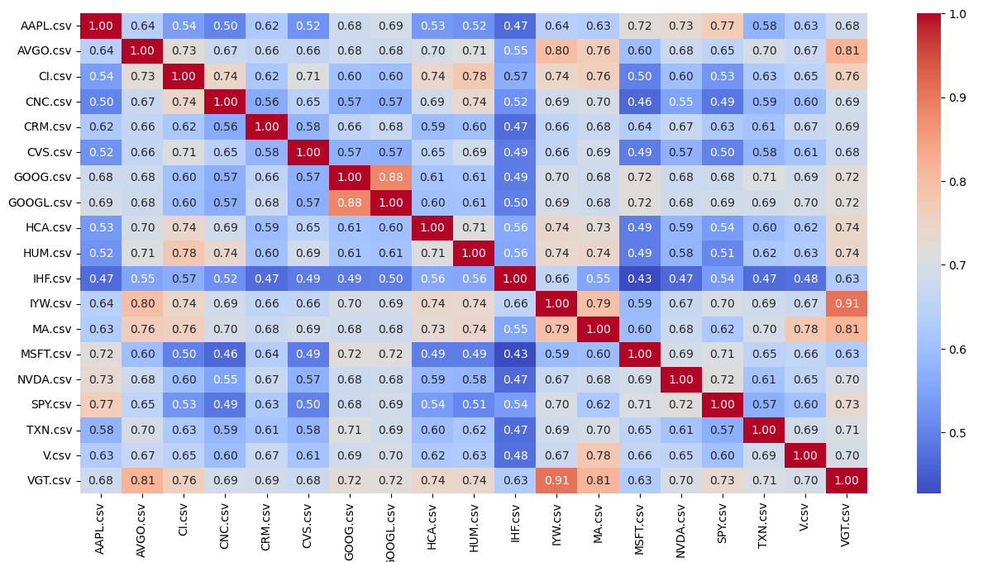
Correlation heat map
VGT and IYW are highly correlated
PAIRS TRADING!

Slide 3
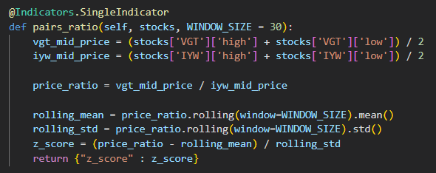
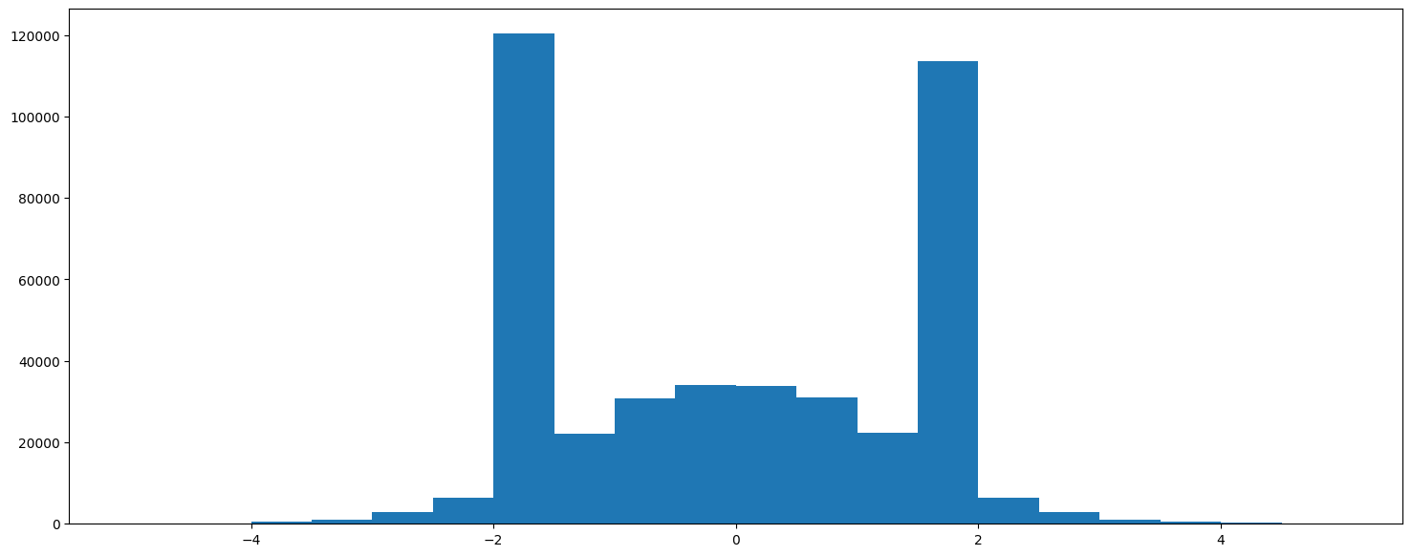
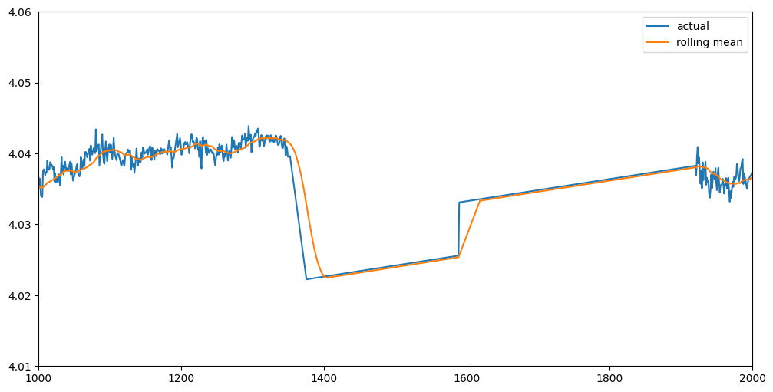
Pairs Trading - Indicator

Slide 4
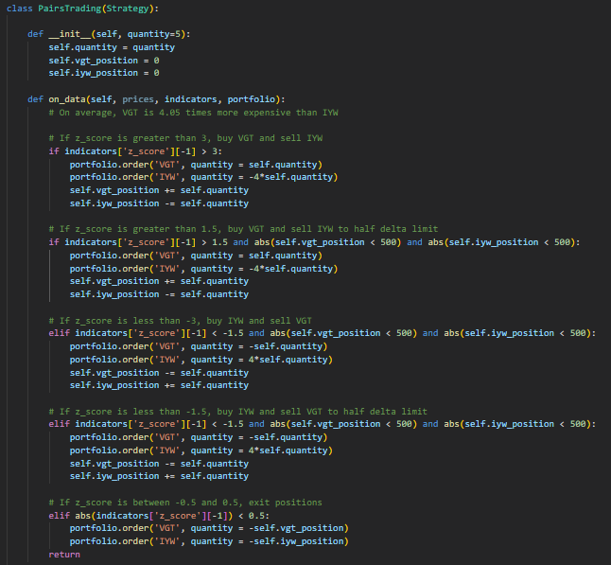
Pairs Trading - Strategy

Slide 5
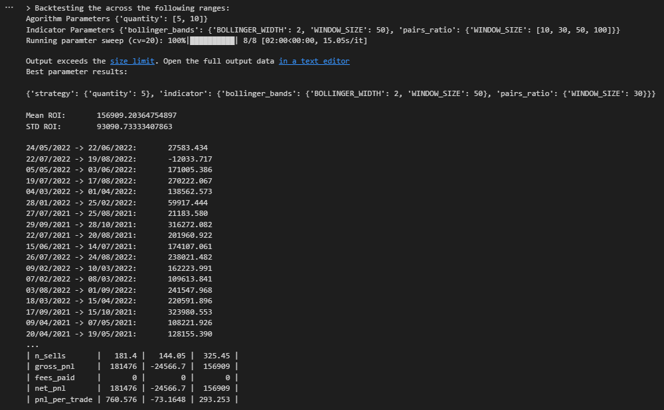
Pairs Strategy - Results
Using grid search, the best order quantity is 5 and the best window size is 30.
Consistently positive PNL over 20 runs
Next steps:
Implement stop-losses
Optimise entry and exit bounds

Slide 6
Volatility

